Slide 1

Yelp Recommendations and Sentimental Analysis
Monas Bhar
Shrikant Mudholkar
Varsha Bhanushali

Slide 2
INTRODUCTION
Yelp is a social network for customer reviews and recommendations about local businesses
Businesses register their business listing with yelp and all the users of yelp online community can share their review about the business
The yelp search engine returns a list of businesses depending upon user choices and yelp’s recommendation engine

Slide 3
RESEARCH SCOPE
Recommend restaurants to the user based on user profile and preferences using model based collaborative filtering
Perform sentiment-analysis on the recommended restaurants reviews
Topic modeling on restaurant review to get a high-level overview of what are things people talking about

Slide 4
MILESTONES
Data Streaming in distributed system
Data Preprocessing
Data Cleaning, handling missing values
Exploratory Data Analysis
Collaborative and Content-based Filtering
Recommendation based on Social Network
Work on implementing Sentiment Analysis on text reviews

Slide 5
TECHNOLOGICAL STACK
Structured streaming of data from S3 bucket
Apache Spark (PySpark) for data cleaning and segregation
GraphFrames for Network Analysis
Spark ML for ALS Matrix Factorization Model

Slide 6
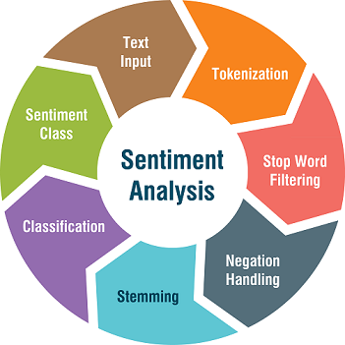

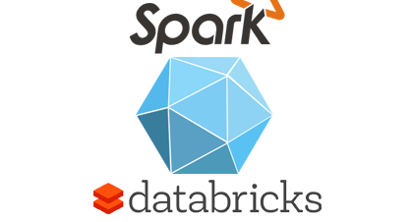
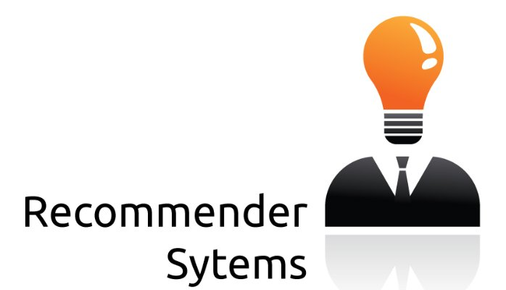
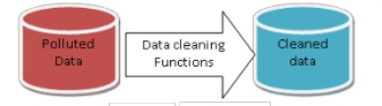
DATA-FLOW
ALS Trained Model

Slide 7
LOADING LARGE DATA IN SPARK
Loaded the 6 GB data into S3 bucket
Mounted the S3 bucket data to the Spark environment
Streamed the data in a distributed machine

Slide 8
DATA PRE-PROCESSING AND EDA
Data Cleaning
Cherry pick the categories to filter restaurants from other business categories
Select top states with most restaurants and high ratings
Filtering the data state-wise

Slide 9
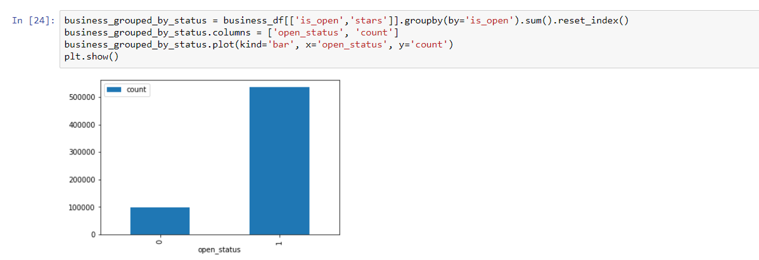
Filter out the business which are open

Slide 10
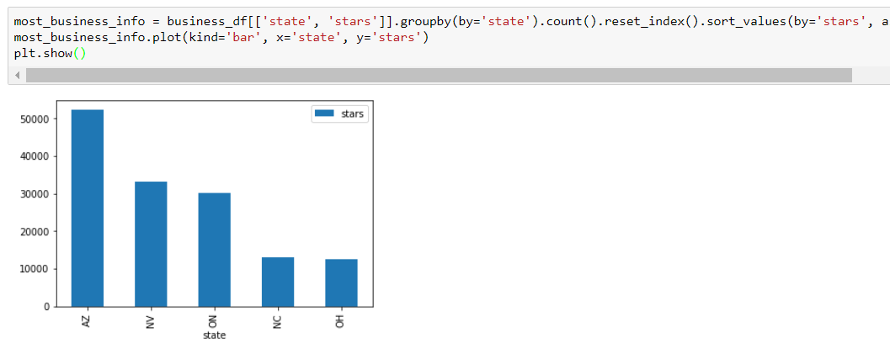
segregate the top state data with most restaurants and high ratings

Slide 11
ALGORITHMS
Alternating Least Squares (ALS)
Latent Dirichlet Allocation (LDA)
Natural language toolkit (NLTK)

Slide 12
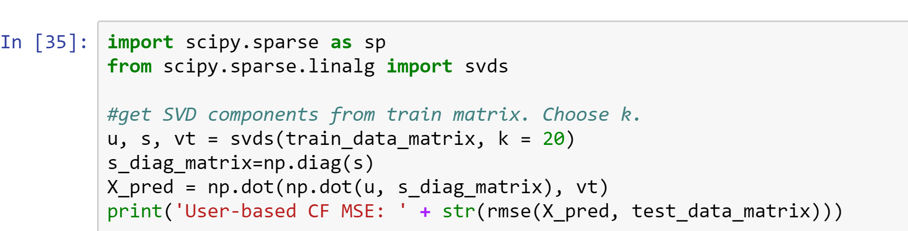
RECOMMENDATION MODELS
Collaborative Filtering
Recommendation using users past preference and examining current data
SVD model
The RMSE of the model wasn’t as per standards and the model was taking more time that expected to train

Slide 13
ALTERNATING LEAST SQUARES
We construct a Matrix Factorization model using three features of data
Resulting model is capable of answering the following:
Products for Users
Users of a given Product
We evaluate the model on basis of RMSE score

Slide 14
Merge different data entites (Business, user, review) state wise
Split the data into test and train data
Fit ALS model on train data
ALS Process Flow
Predict on the test data using the fitted model
Find RMSE
Save Models
14

Slide 15
Plan for next goal

Slide 16
SOCIAL NETWORKS DATA MINING(ON-GOING)
Recommendation based on user’s friend list
Created networks of users connecting to their friends using GraphFrames
Using few SQL joins, group by aggregate commands we will be able to come up with intuitive rating estimations based on friend’s reviews

Slide 17
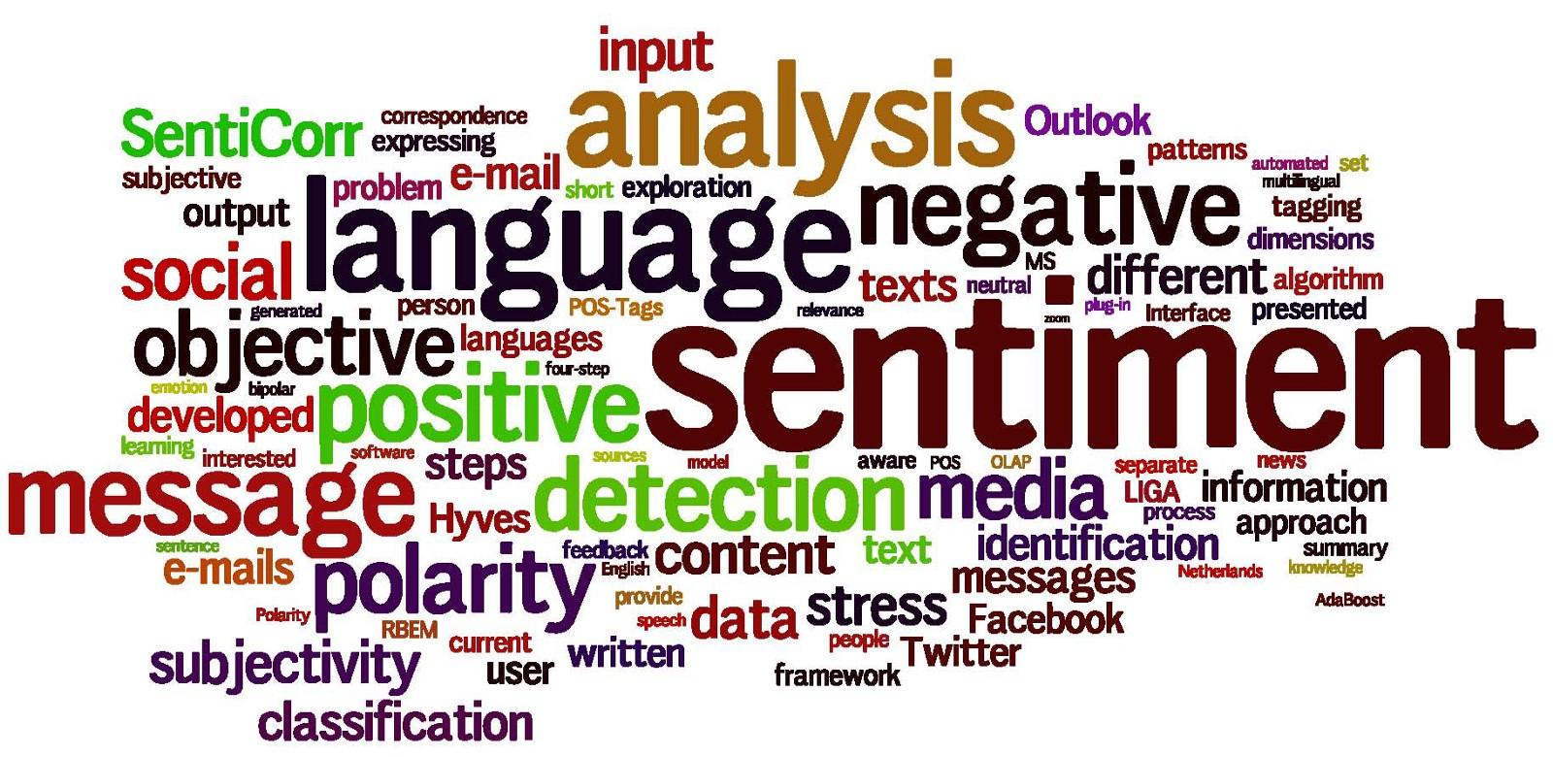
SENTIMENT ANALYSIS
Analyze reviews of restaurants in each state
Calculate sentiment polarizing score using textblob
Apply topic modelling using Latent Dirichlet allocation (LDA) for each restaurant

Slide 18
NEXT STEPS
Content-based Filtering
Sentiment Analysis
Build an automation pipeline for data ingestion and cleaning
Build a web application to demonstrate the recommendation system

Slide 19
THANKS!
Any questions?

